Slide 1


SMART INDIA HACKATHON 2024
Smart Traffic Lights – Prioritizing Emergency Vehicles
Problem Statement ID - SIH1594
Problem Statement Title - Student Innovation
Theme - Transportation & Logistics
PS Category - Software
Team ID -
Team Name - TrafficCrew

Slide 2
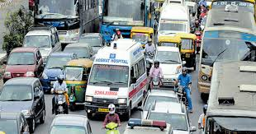
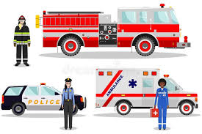
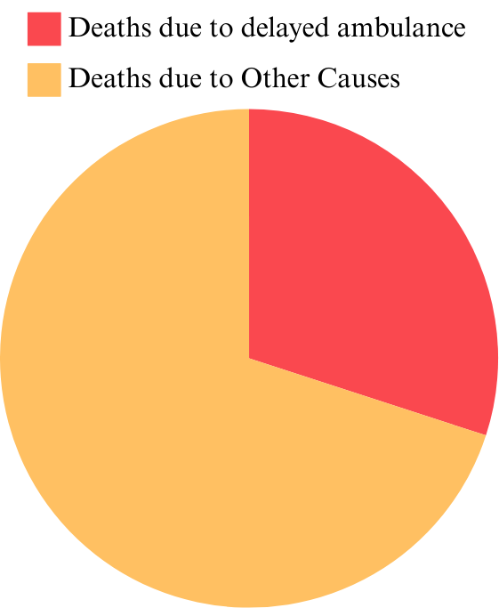
SMART TRAFFIC LIGHTS
TrafficCrew
Integrating Deep Learning Technology to detect emergency vehicles
30%
70%
Ambulance Stuck at Traffic Signal
Fire – Crime - Medical Emergencies
Deaths caused by delays - india
Proposed Solution :
Detecting emergency vehicles stuck at traffic signals
prioritizing them by automatically activating a green signal.
Innovation & Uniqueness :
Advanced Prioritization Algorithm.

Slide 3
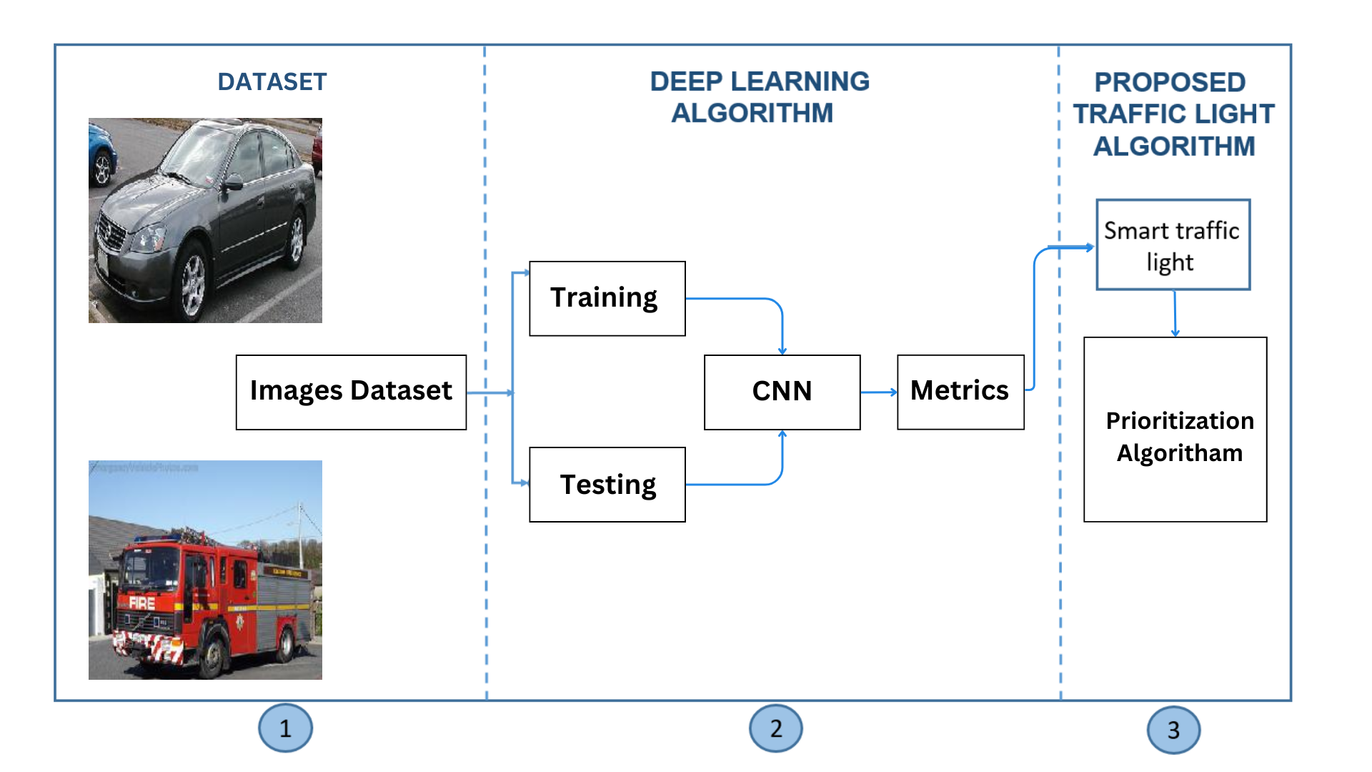
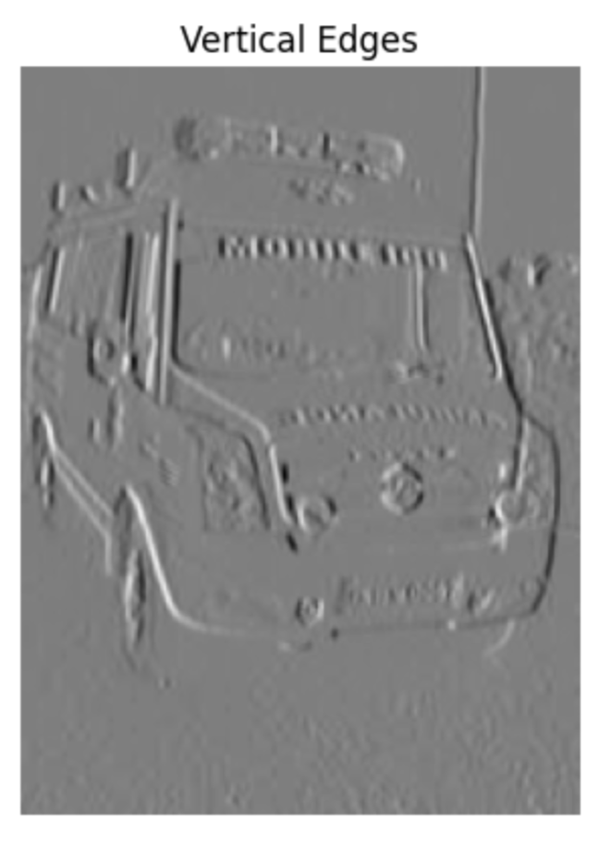
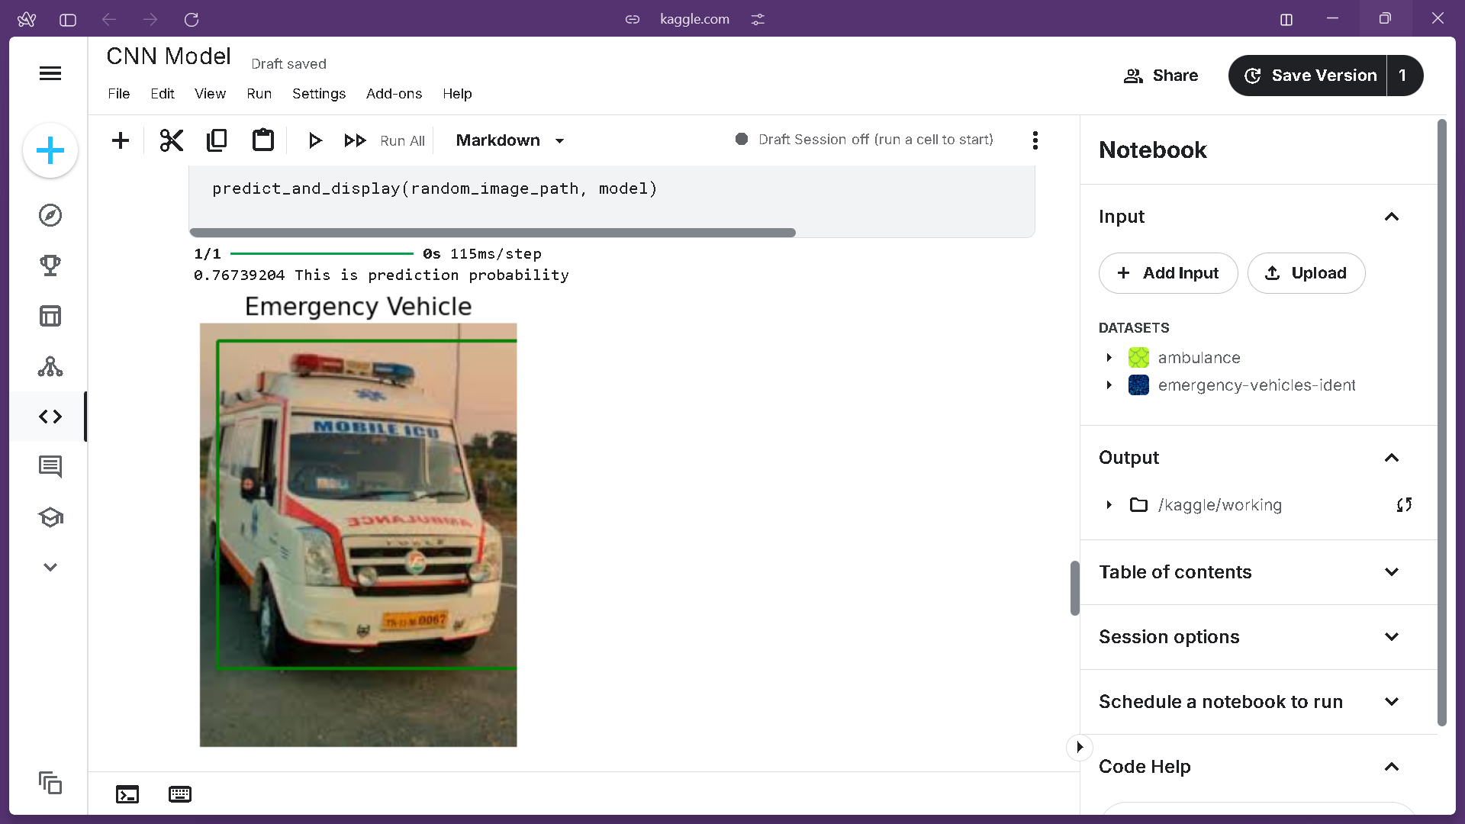
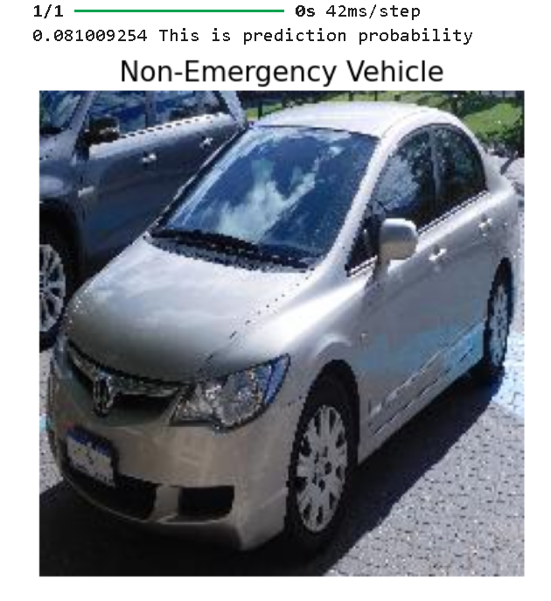
TECHNICAL APPROACH
TrafficCrew
Block Diagram:
Technology Stack :
Python.
TensorFlow, CNN, Yolov5
Hardware:
Cameras(Night Vision, Weather Resistance, 1080p-4k)
GPUs -512 CUDA cores
Flowchart/Algorithm:
START
Traffic Light Monitoring
NO
Is Emg Vehicle Detected?
YES
Multiple Emg Vehicles?
Output:
YES
Check Priority
NO
Check Distance
Check Next Signal time for that lane?
Give Green till vehicle passes signal
END

Slide 4



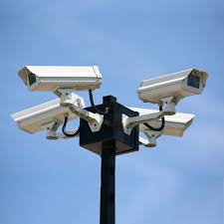
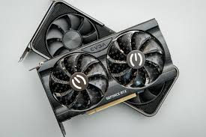


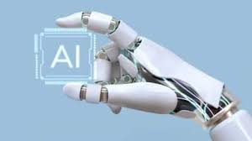



FEASIBILITY AND VIABILITY
TrafficCrew
Feasibility
Viability
Reliable
Technology
System compatibility
System compatibility
High Demand
Available Resources
System compatibility
System compatibility
Improved Flow
Cost-Effective
System compatibility
System compatibility
Trend Alignment
System compatibility
System compatibility
System compatibility
Enhance Efficiency

Slide 5



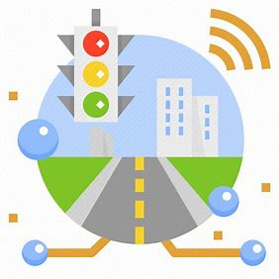
IMPACT AND BENEFITS
TrafficCrew
IMPACT
SOCIAL
ECONOMIC
ENVIRONMENTAL
TARGET AUDIENCE
BENEFITS
Efficiency Safety Integration Scalability

Slide 6
RESEARCH AND REFERENCES
TrafficCrew
[1] Dataset – [https://www.kaggle.com/datasets/abhisheksinghblr/emergency-vehicles-identification]
[2] Working of Traffic Lights-[https://practical.engineering/blog/2019/5/11/how-do-traffic-signals-work]
[3] Traffic Rules and Traffic Violation Fines in India (As per MV Act 2019)[https://www.acko.com/traffic-rules/]
[4] B. K. Shashi, "Ambulance Stuck in Traffic: Scary Right?" Medium,
[5] A. S. Kumar, and R. Patel, "Advanced Traffic Clearance System for Emergency Vehicles," ResearchGate.

